Slide 1
HTML Assignment
NAME: Madhuvanthi .J
BATCH: pod-webdev23-11

Slide 2
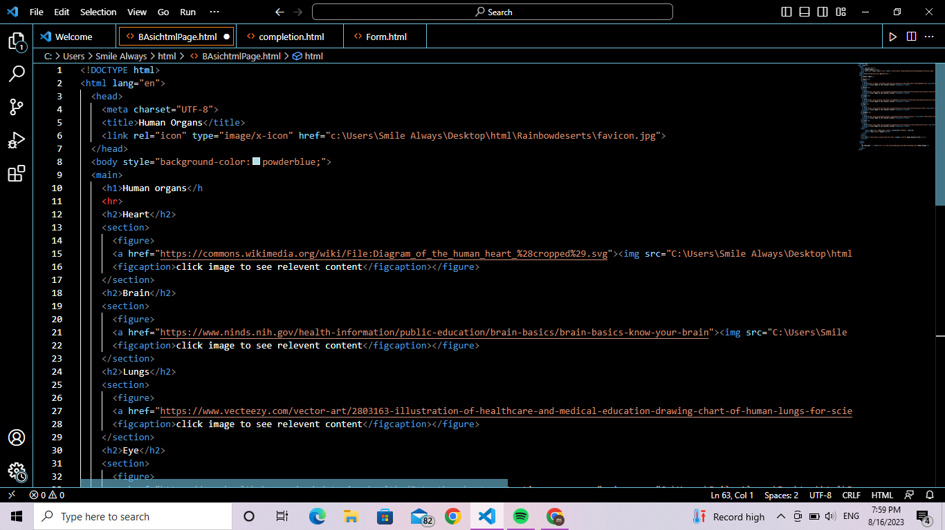
Task 1: Basic Webpage
HTML Code:

Slide 3
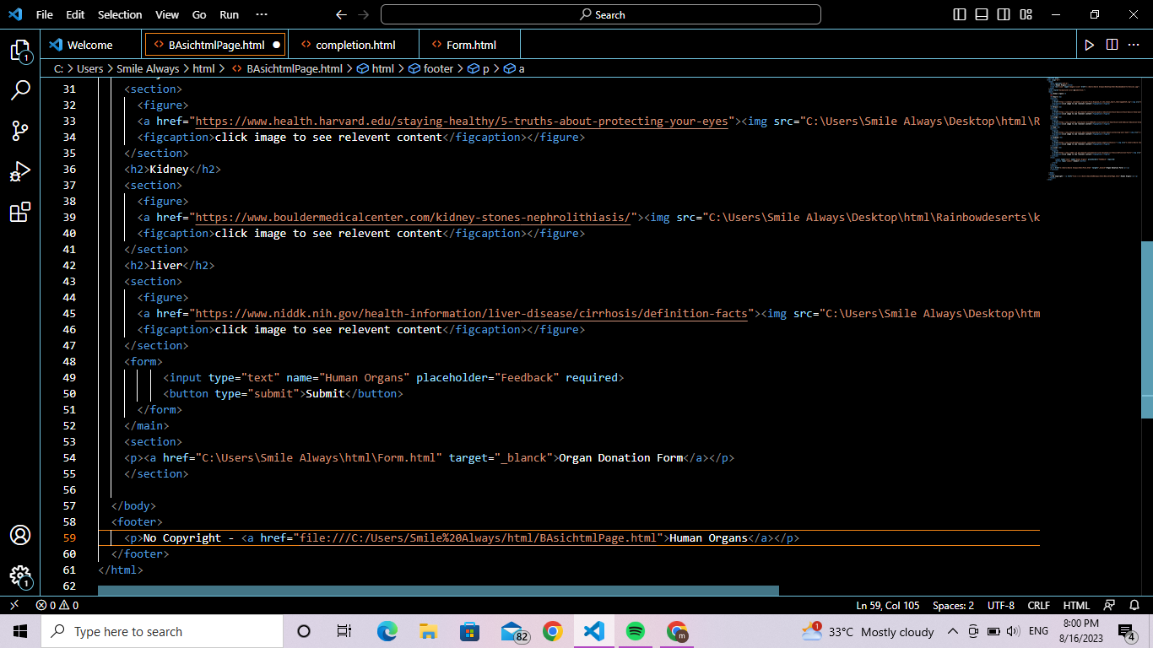

Slide 4
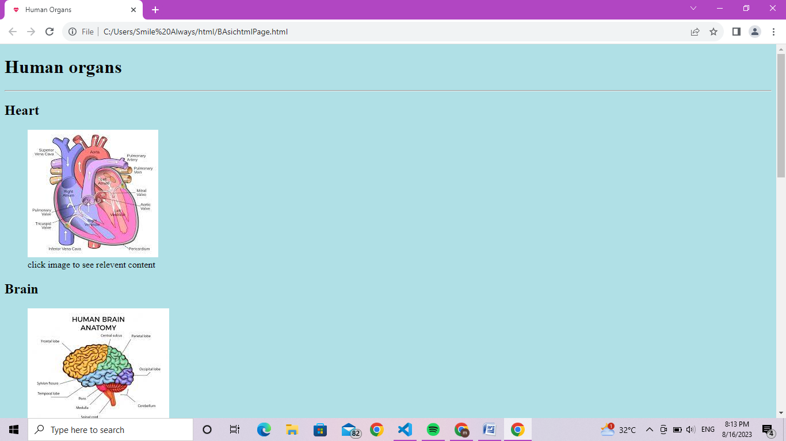
OUTPUT:

Slide 5
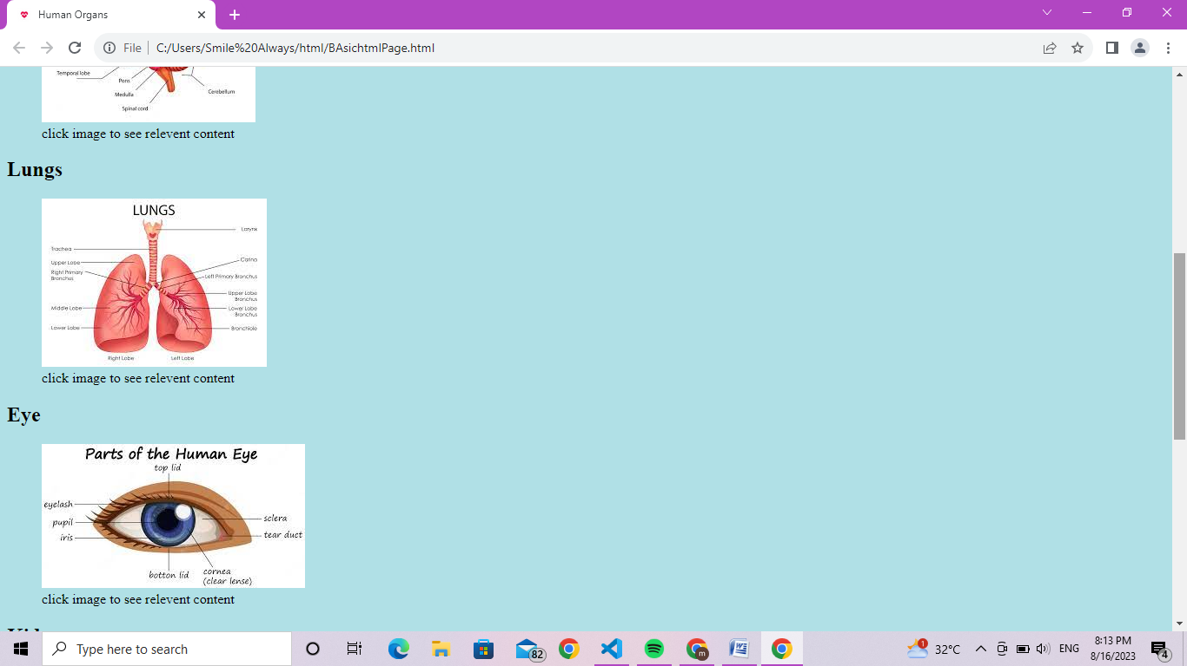
OUTPUT:

Slide 6
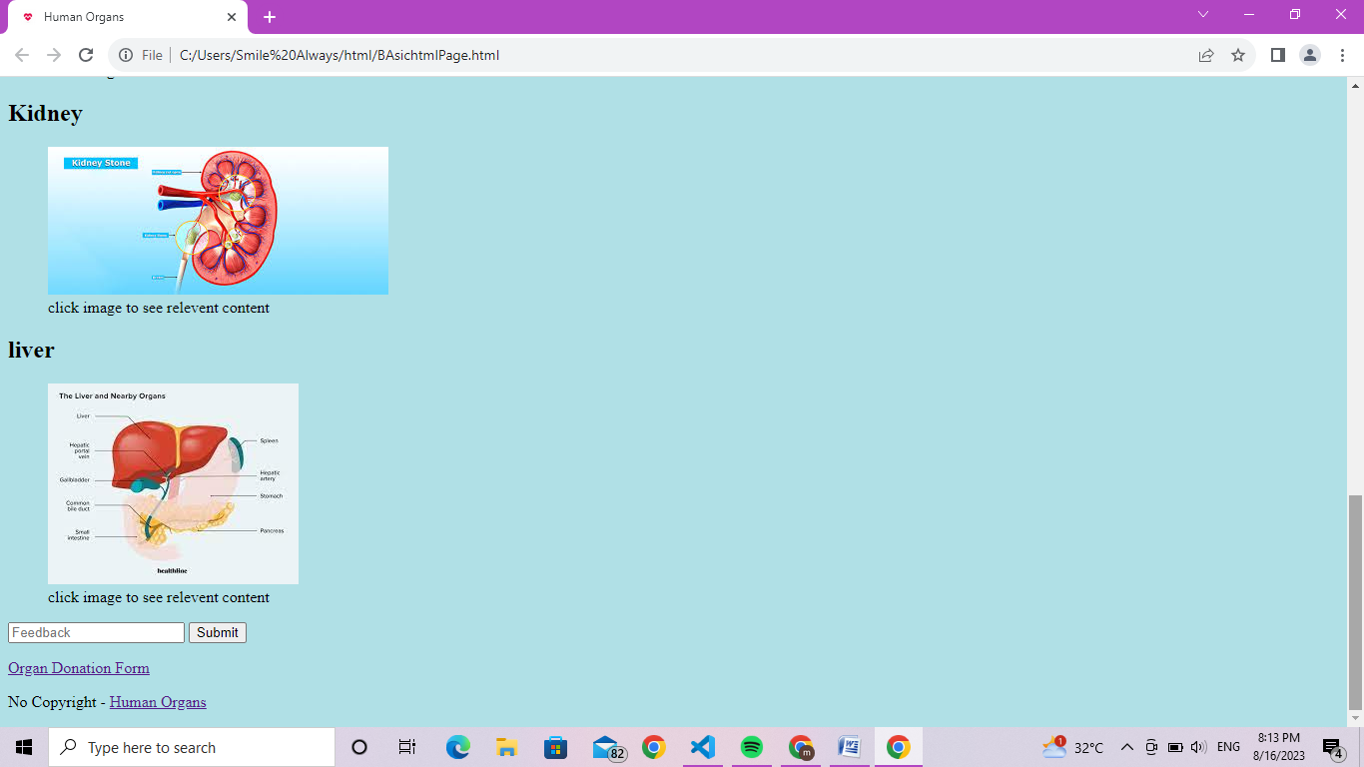
OUTPUT:

Slide 8
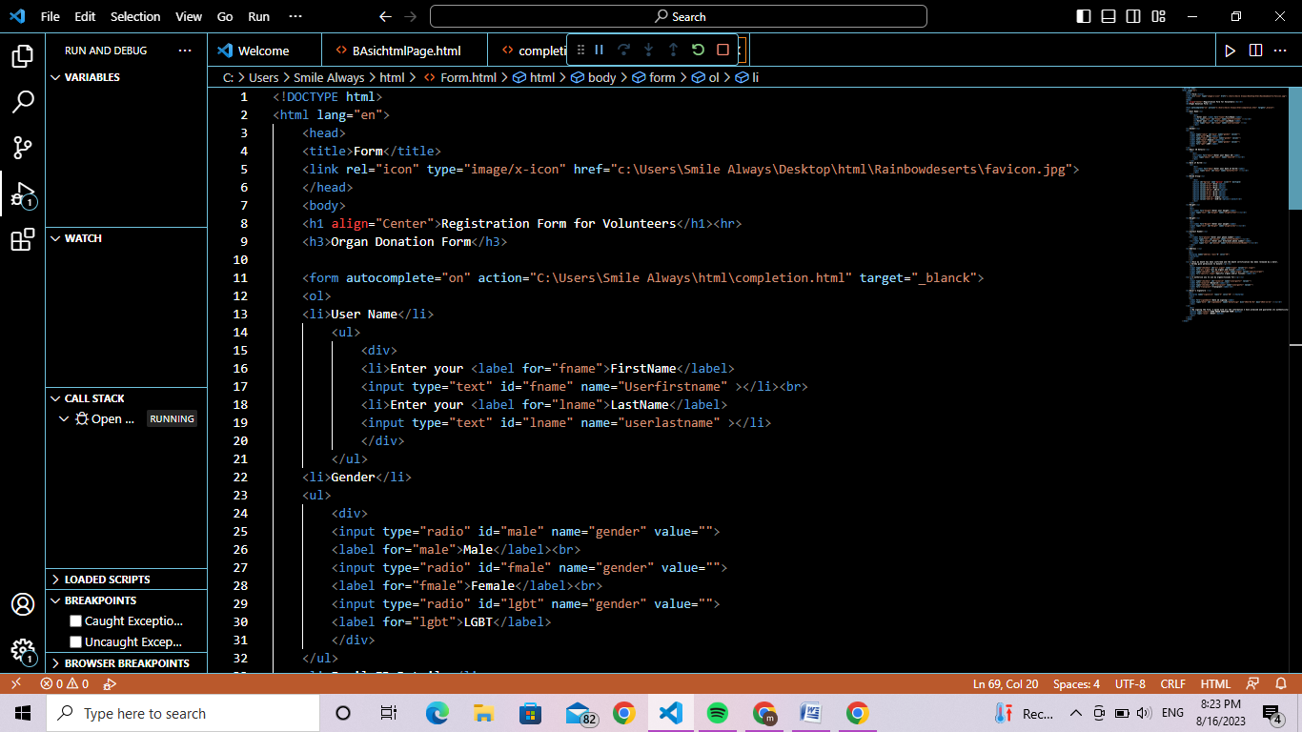
Task 2: Registration Form

Slide 9
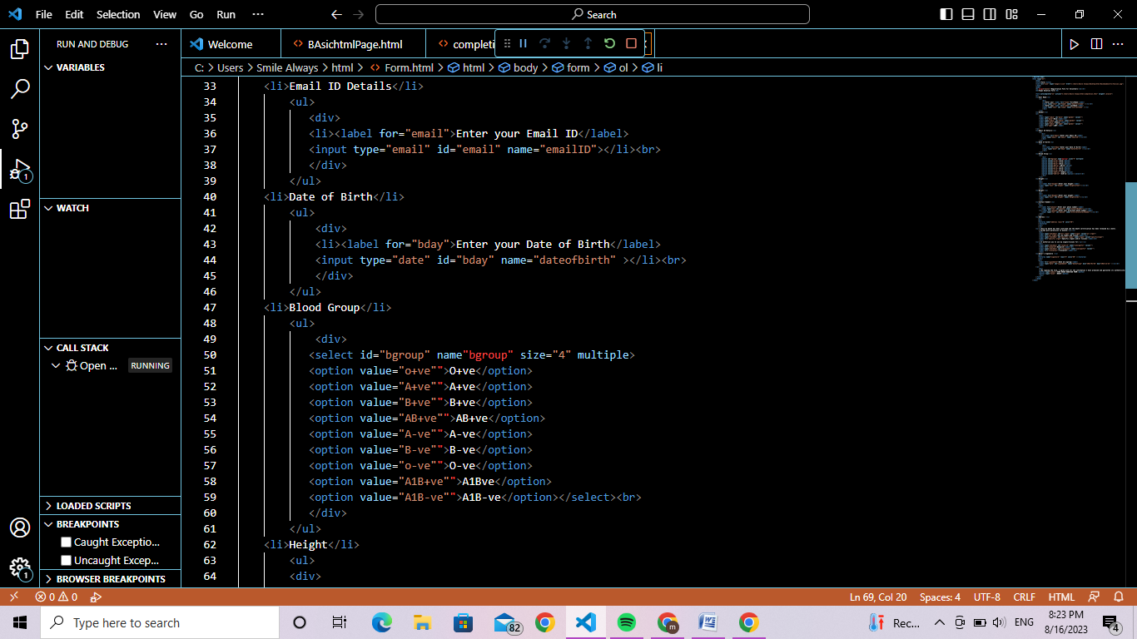

Slide 10
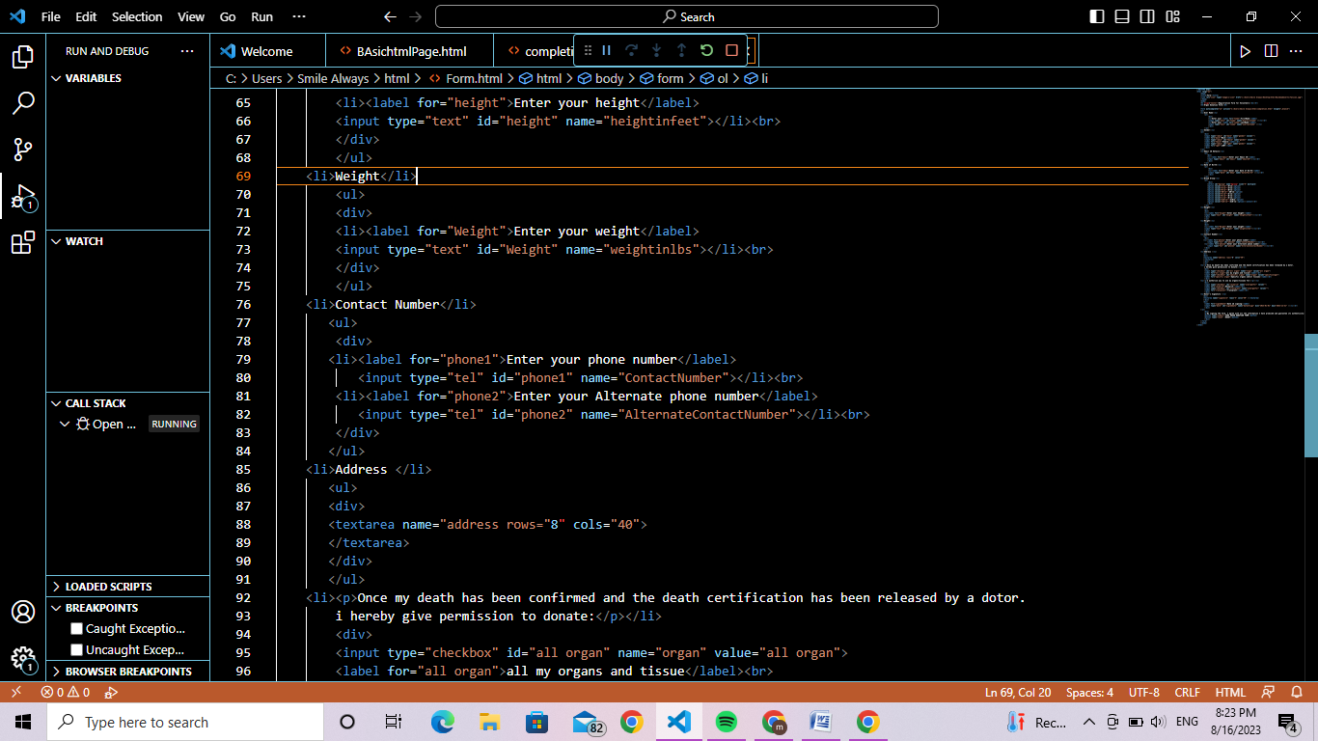

Slide 11
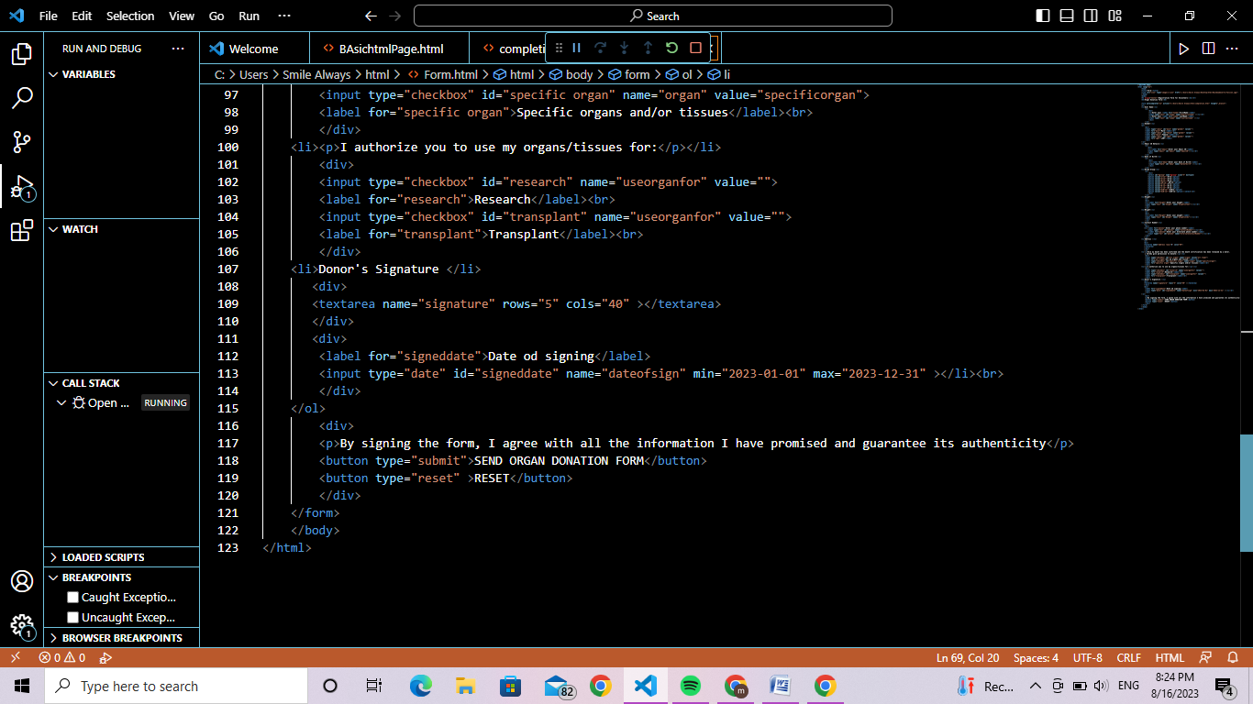

Slide 12
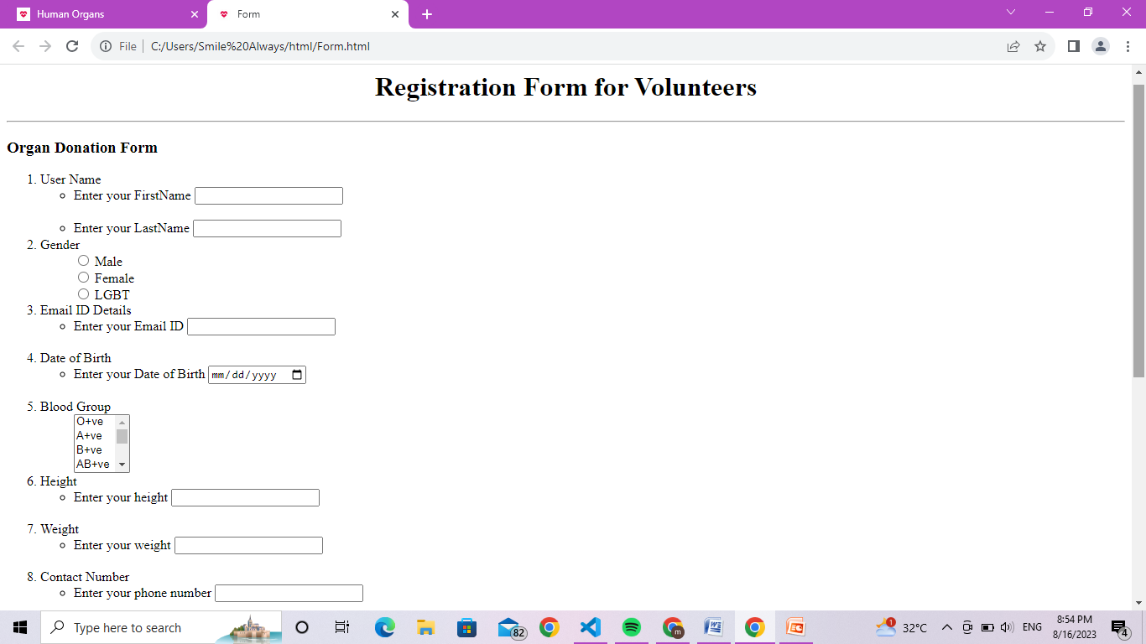
OUTPUT:

Slide 13
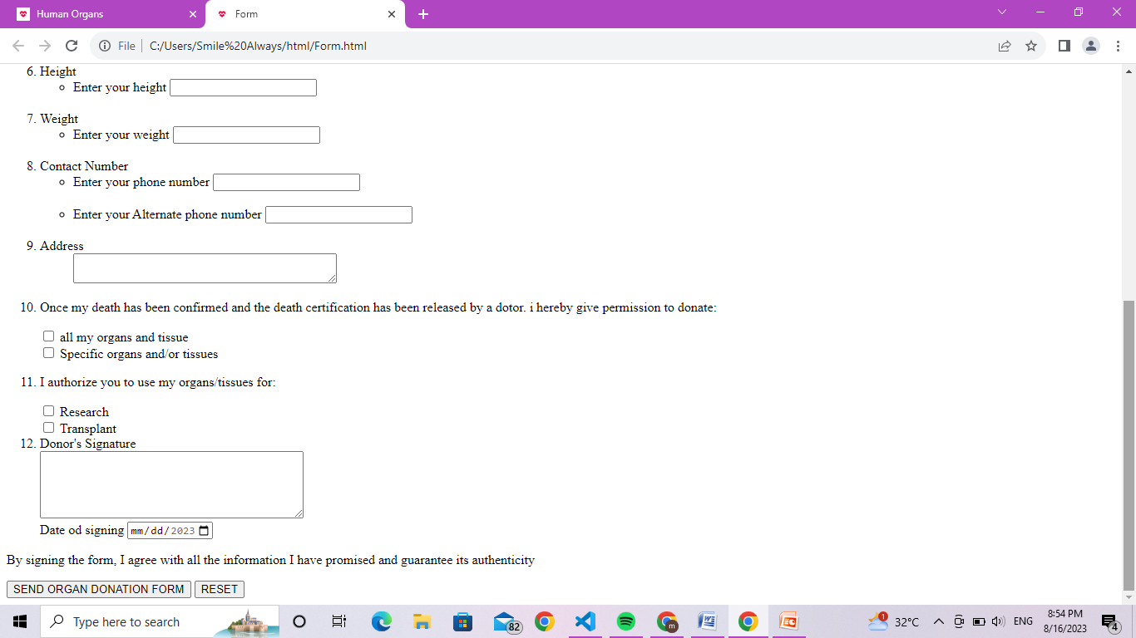
OUTPUT:

Slide 14
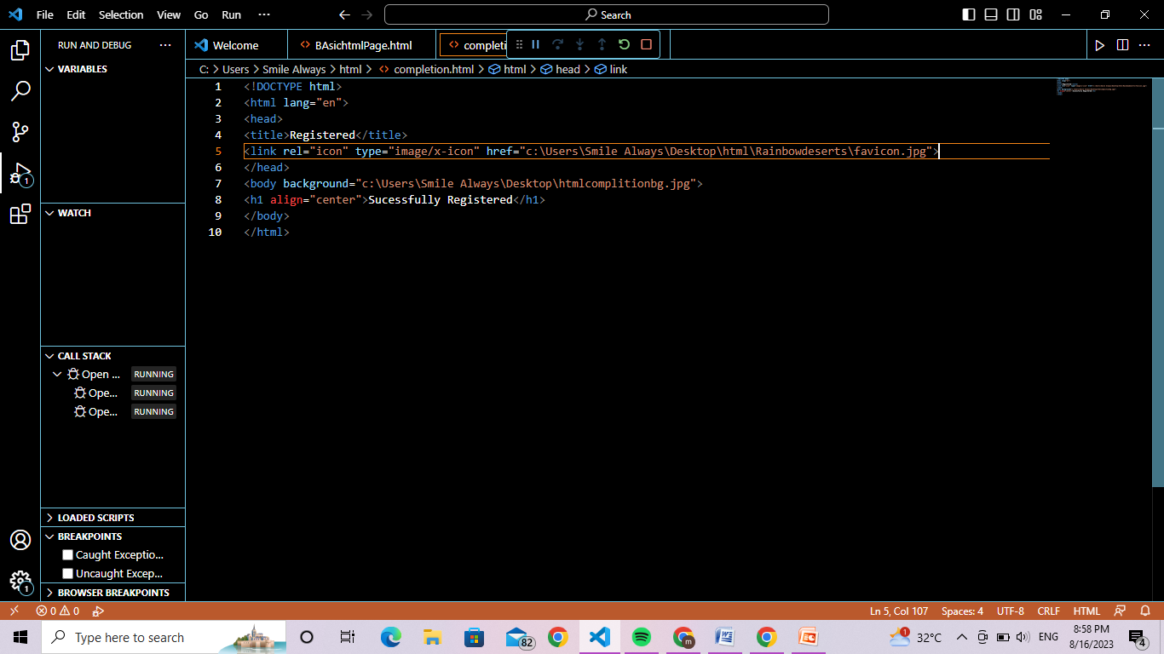
HTML Code:

Slide 15
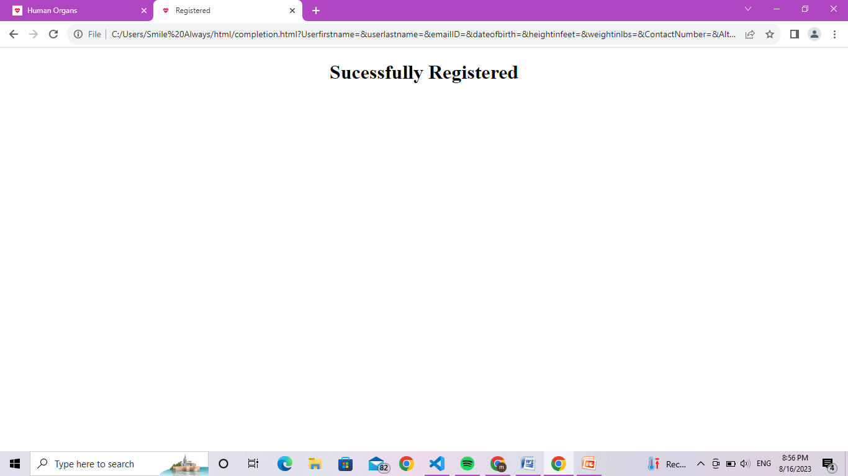
OUTPUT:

